Slide 1

Exit Exam
Preparation/Practice
Application
Team G
Presented by: Garrett Johnson, Chris Anthony, Jose Soto, Sandesh Pathak

Slide 2
Team Organization
Scrum Meetings: 5 - 30 minutes after class and on weekends
Discord for communication: In times where nobody is available, messages would be left in discord to be viewed later, important message would be pinned.
Garrett would lead meetings, if unavailable, Jose would take over.

Slide 3

Description of Problem
Create software that can assist in studying for the Computer Science Exit Exam
This can be done though either by studying specific concepts/topics exams or by taking a practice test.

Slide 4
Requirements
Must be created with Python
Must use JSON to store questions
Must be standalone
Must be able to save a session that can be continued later
Must have backup question to add variety
An explanation must be provided on wrong answers

Slide 5





Development Tools
Github
VSCode
Replit
Draw.io
Google application (slides and docs)

Slide 6
User environment
Available for Widows, Mac, & Linux Systems
Processor: 1 GHz
Hard Disk: 1 GB
RAM: 1 GB
Display: 800x600
Input Device: Mouse

Slide 7
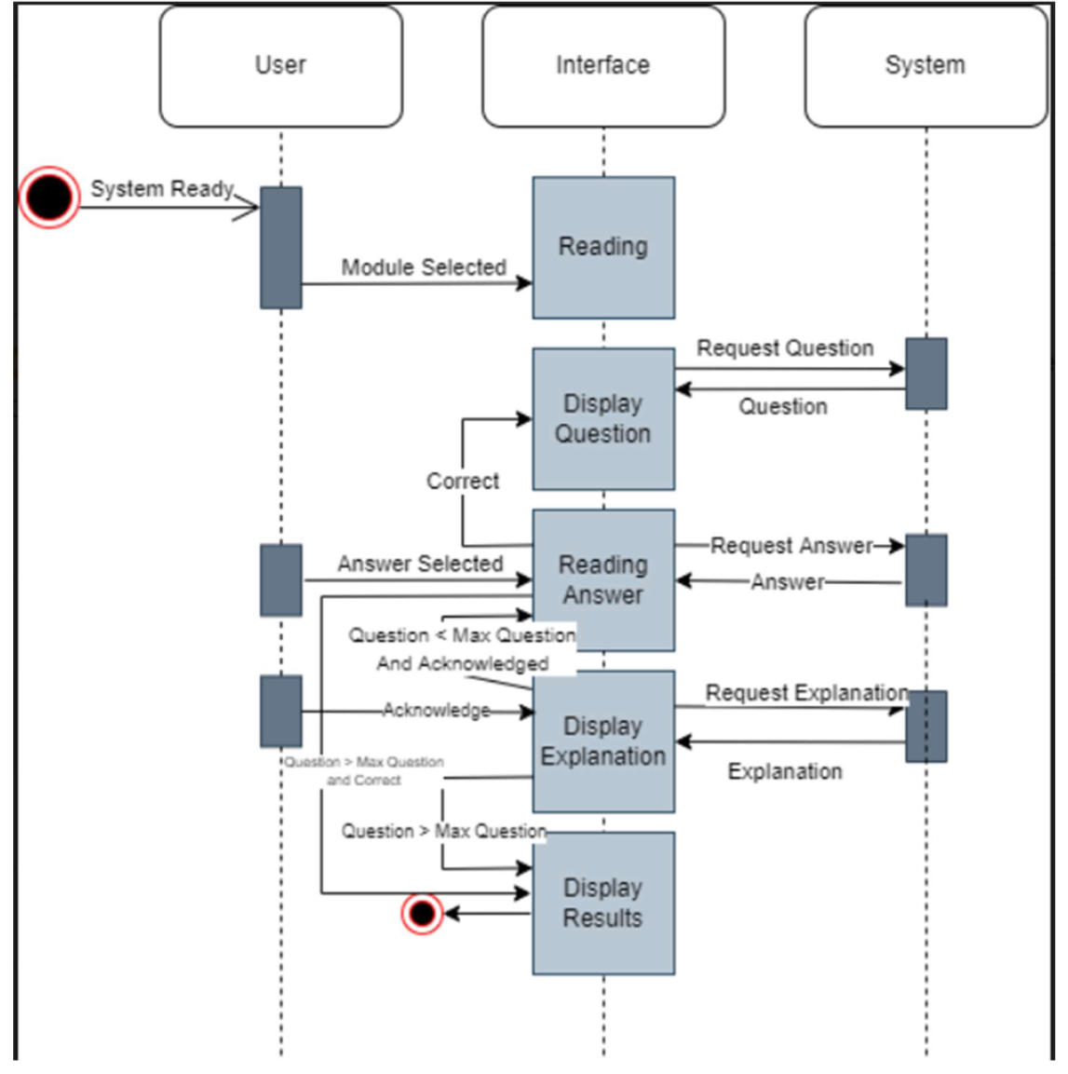
UML Sequence Diagram

Slide 8
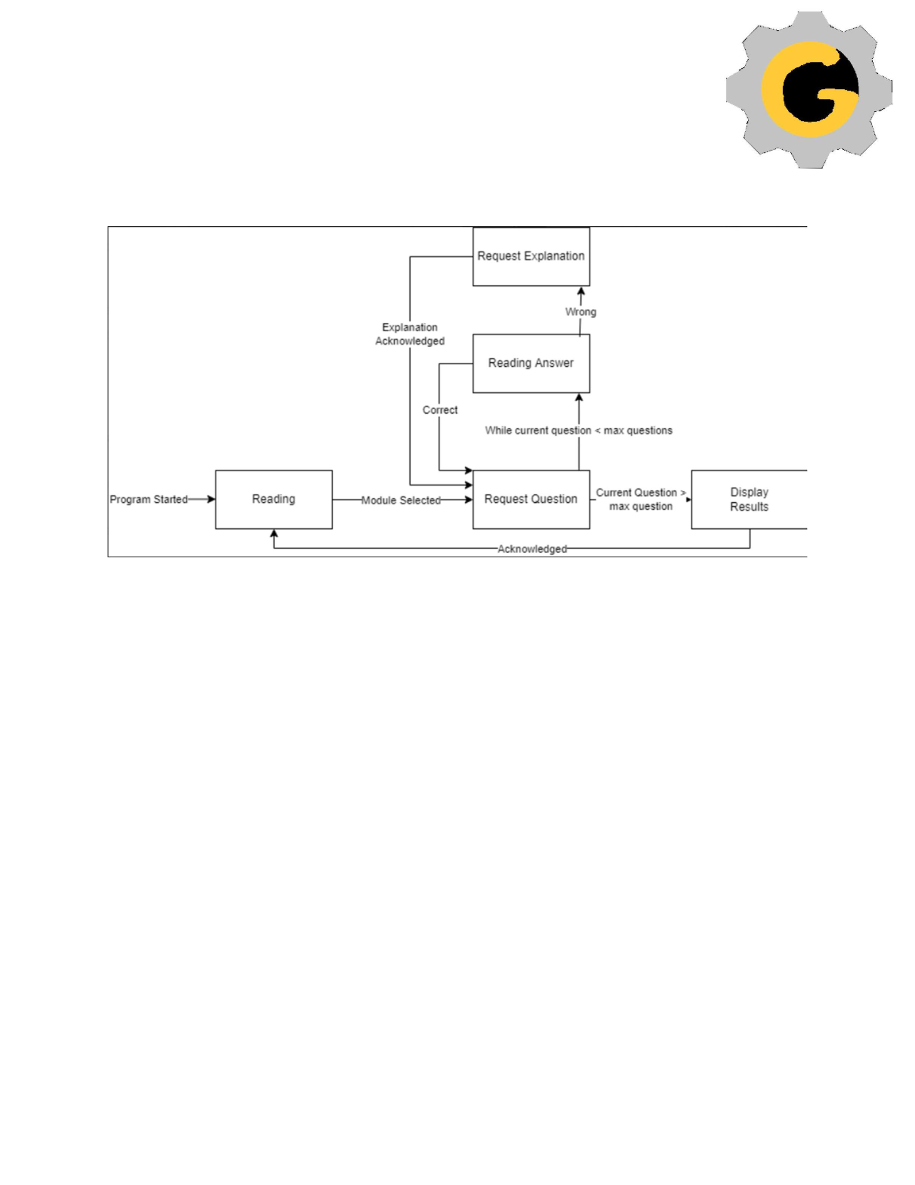
UML State Diagram

Slide 9
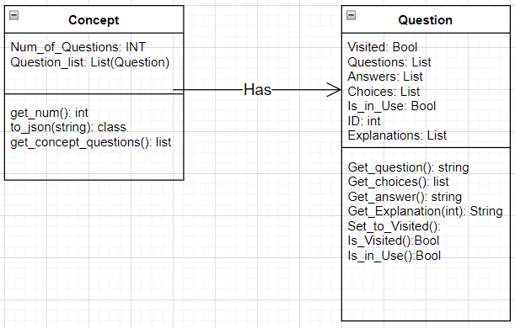
Class Diagram

Slide 10
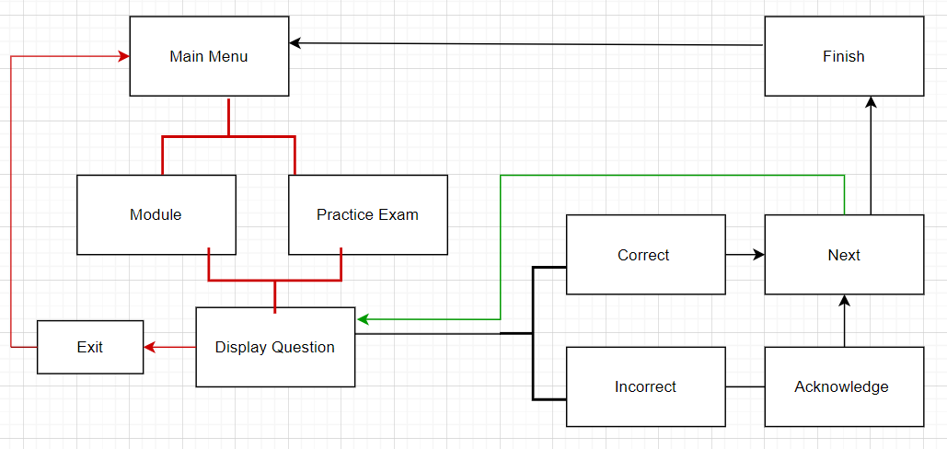
User Interface Design /Navigation
Diagram
.

Slide 11
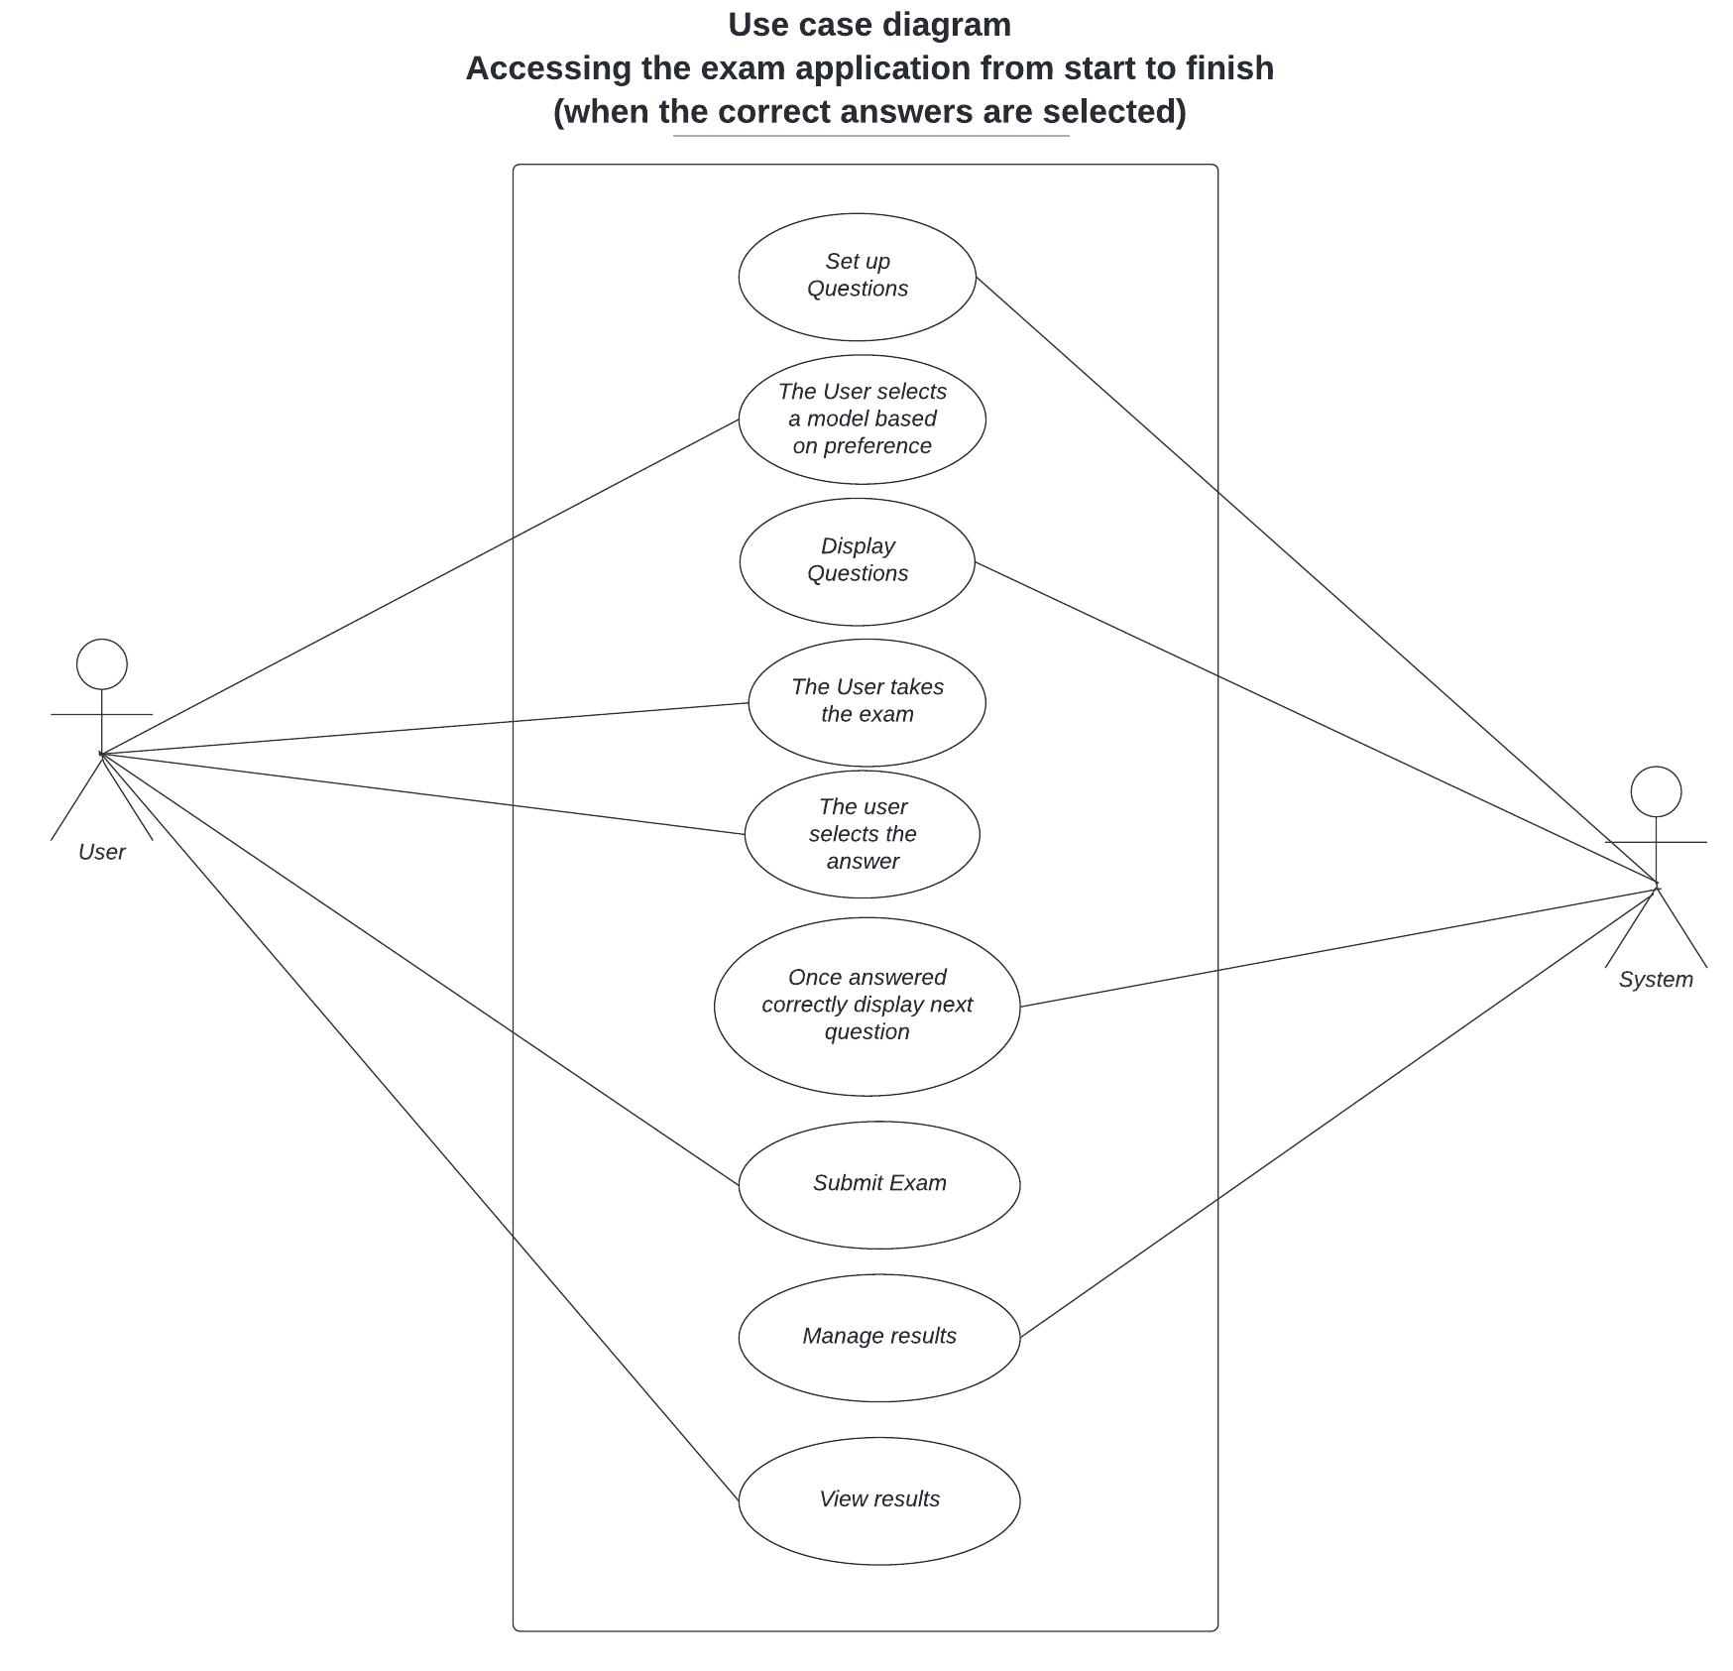
Use Case Diagram 1

Slide 12
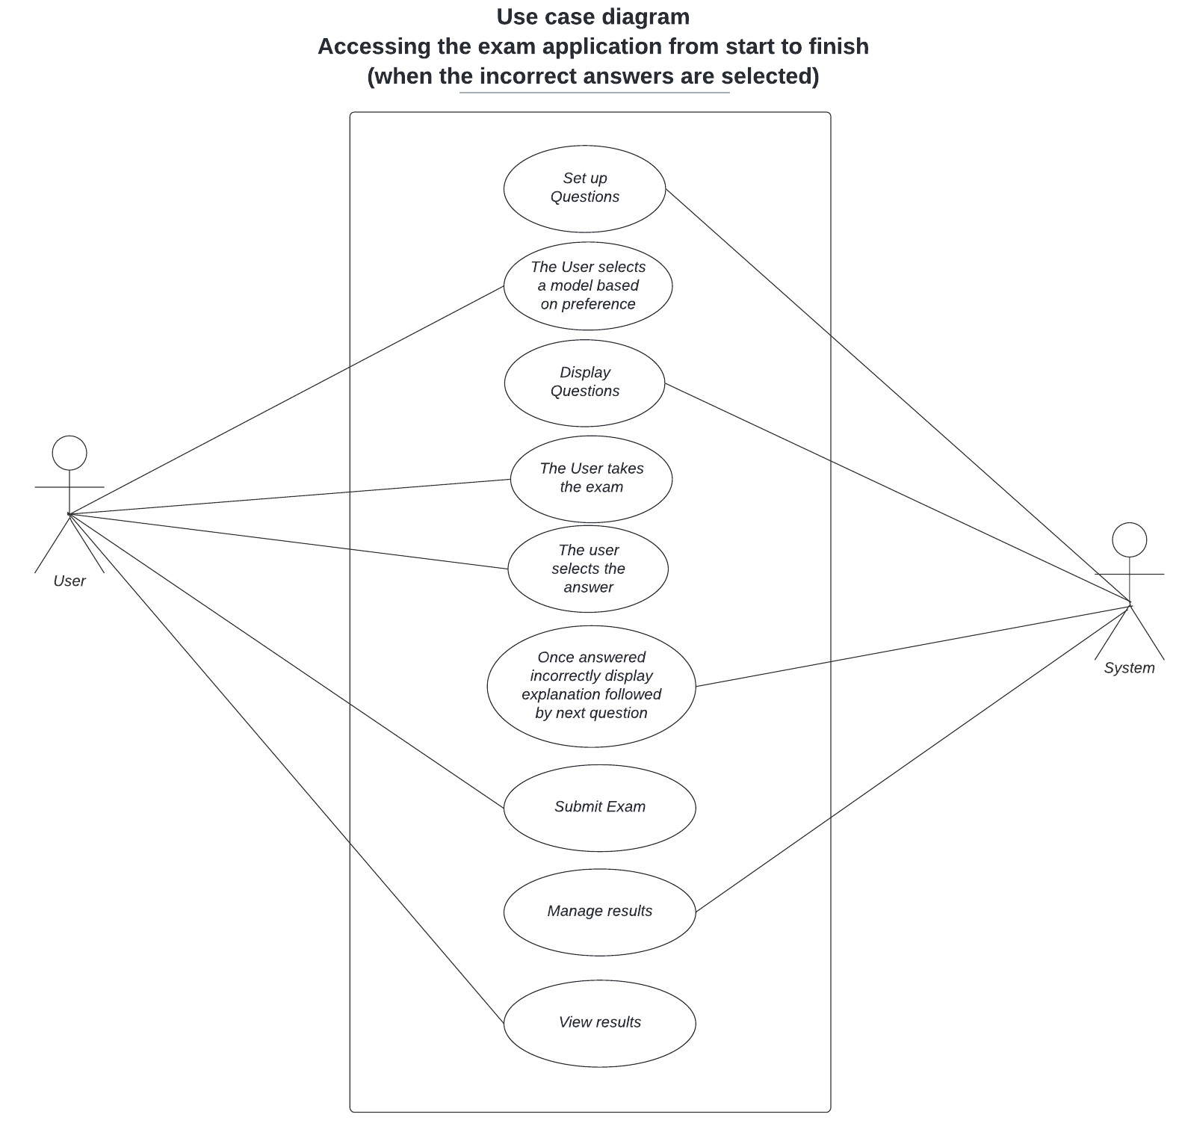
Use Case Diagram 2

Slide 13

Possible Future Project Ideas
Include randomization among questions
Include Save Function
Add Timer-based mode
Add Topic-based mode
Show Progress in each subject
Additional sound effects (Maybe)
Hint System (Maybe)
Mobile Compatibility

Slide 14
Conclusion
Application will:
Be easy to use
Provide Information on multiple Computer Science topics
Be a useful tool to prepare for an exit exam
Idea of what stakeholder gets as a final product.

Slide 15


